Slide 1
Different Landscapes-
Different
Countries
What do you know about Britain?

Slide 2
Закончите предложения:
The United Kingdom is situated…
The UK includes …
The capital of the country is…
The population of the UK is…
The British nation consists of the…
The climate of Great Britain is…
The main river is…
The famous universities are…
The head of the Government is…

Slide 3
British flag
UNION JACK

Slide 4
English Flag
The red cross on white of St. George of England

Slide 5
Scottish Flag
The white “X” on blue of St Andrew for Scotland

Slide 6
Irish Flag
The red “X” on white of St. Patrick for Ireland

Slide 7
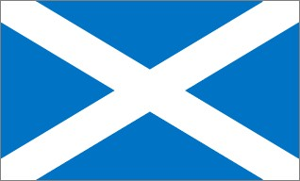
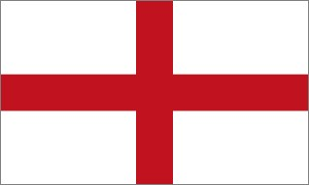
Finally when we put
one Flag to another
we will have “Union Jack”

Slide 8
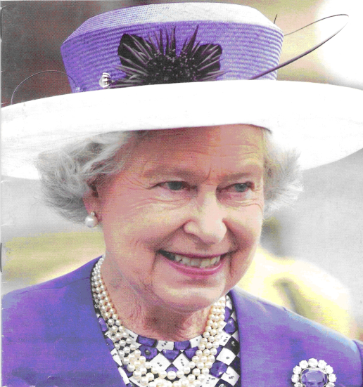
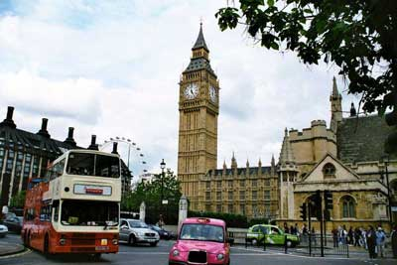
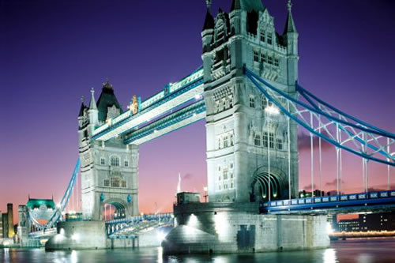
Столица всей страны и Англии – Лондон (London)

Slide 9
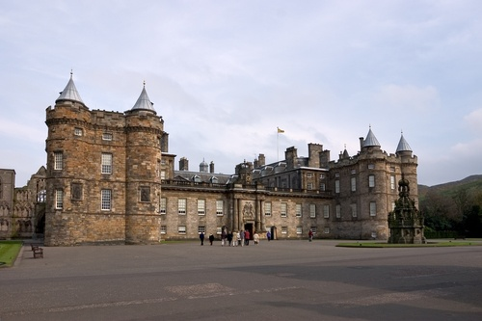
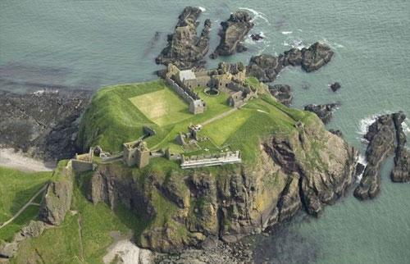
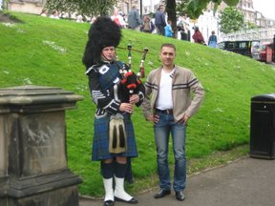
Столица Шотландии – Эдинбург (Edinburgh)

Slide 10
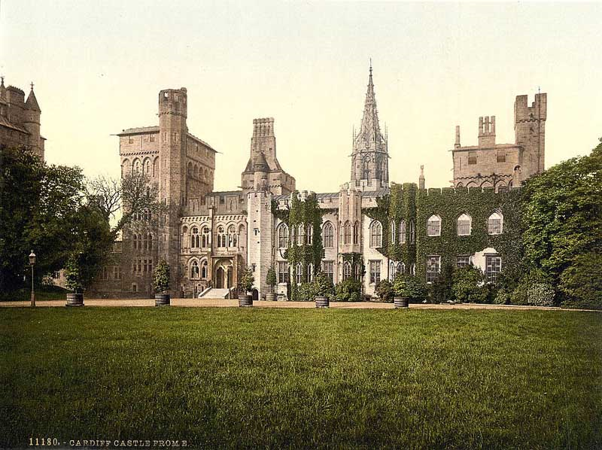
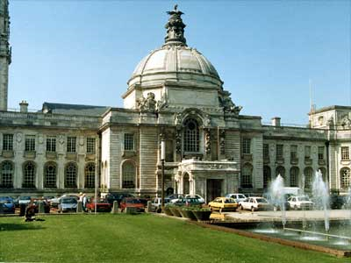
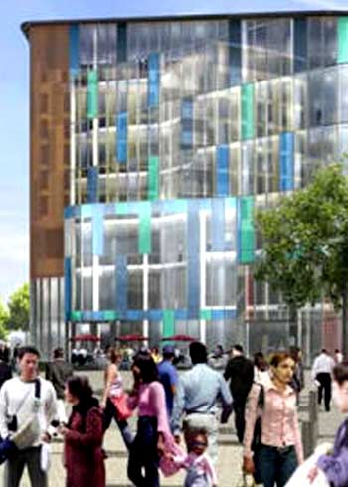
Столица Уэльса – Кардифф (Cardiff)

Slide 11
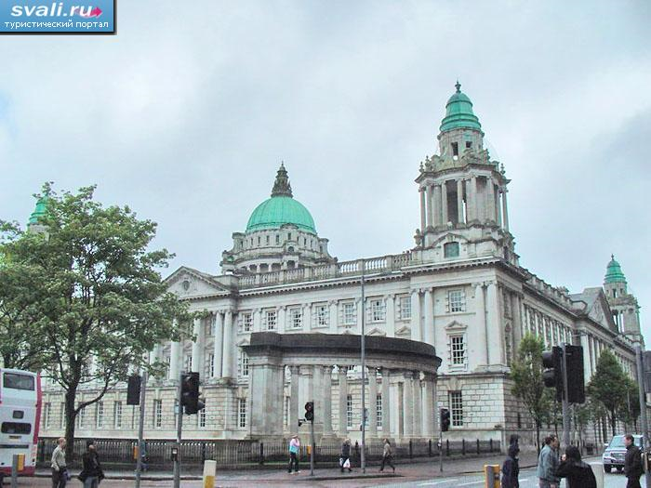
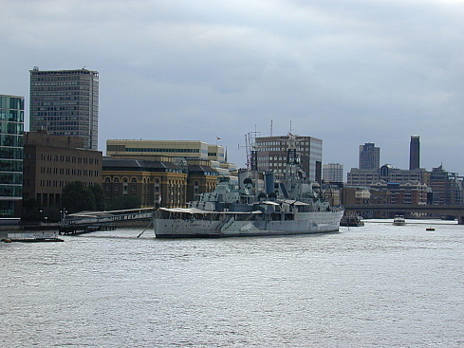
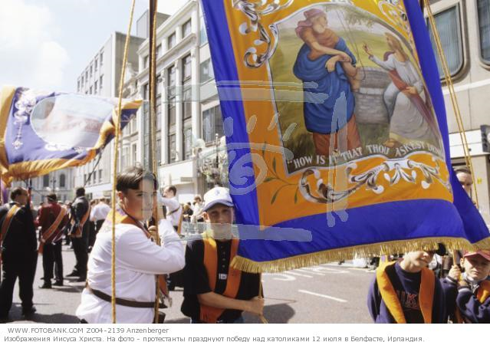
Столица Северной Ирландии (Ольстера) – Белфаст (Belfast)

Slide 12
Выполните тест и оцените себя:
1. The official name of the country is
a) The UK
b)The England
c)The Great Britain
2. The UK is made up of
a) 5 countries
b) 4 countries
c) 3 countries
3. The capital of the UK is
a) Cardiff
b) Edinburgh
c) London
4. The official language of the UK is
a) English
b)Welsh
c) Irish
5. The head of the UK is
a) The Prime Minister
b) The Monarch
c) The President
You score 5 4 3 2
Your mark 5 4 3 2

Slide 13
Правильные ответы:
1-а
2-b
3-c
4-a
5-b
You score 5 4 3 2
Your mark 5 4 3 2

Slide 14
«The UK» The plan:
1) The official name of the country.
2) Countries.
3) Capitals.
4) Flag of the UK.
5) The population of the country.
6) Languages.
7) Sights of the country.

