Slide 1
Famous people of Britain
Подготовила: учитель иностранного языка МКОУ
Утичёвская основная общеобразовательная школа
Фалькова Т.Н.

Slide 2
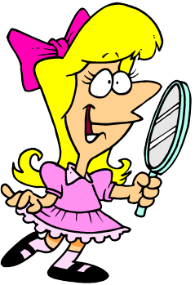
Let’s read English twister.
[b]
Barbara is a beautiful blond
with bright blue eyes.

Slide 3
Answer my questions.
Do you like reading?
Do you have your favorite book?
Which foreign writers do you know?
Do you like watching films?
Which foreign films do you like?
Do you like listening music?
Which genres of music do you like listening?
Which foreign singers do you know?

Slide 4
Match the English words and their Russian equivalents
Scientist музыкант
Writer политик
Architect поэт
Teacher художник
Musician писатель
Poet ученый
Politician учитель
Pointer архитектор

Slide 5
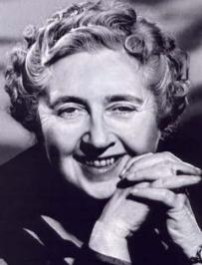
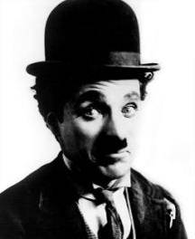
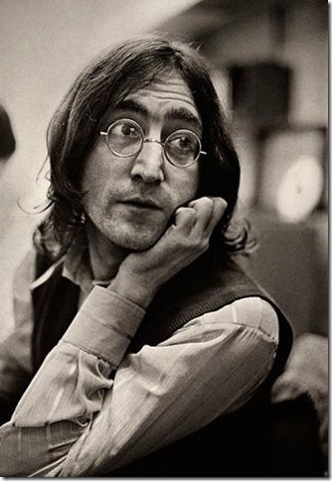
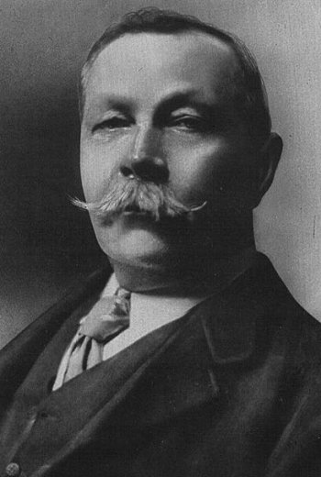
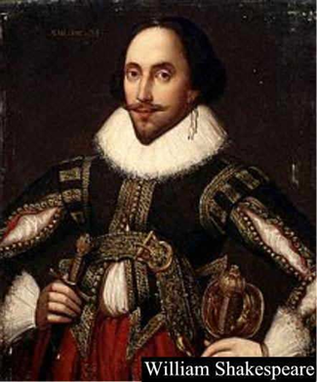
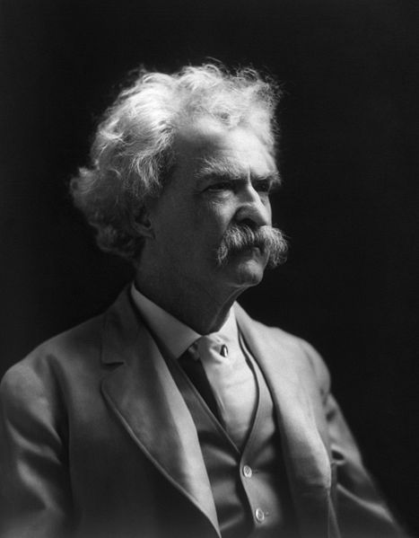
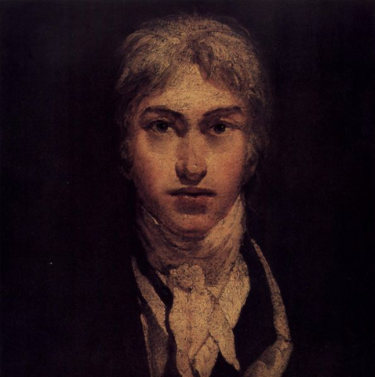
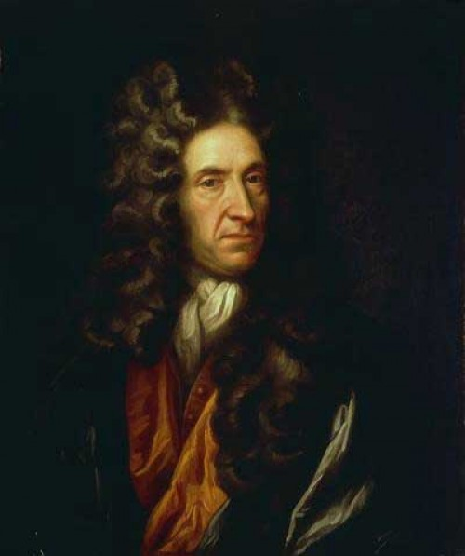
What are these people
famous for?
A. Christie
Ch. Chaplin
J. Lennon
Sir Arthur Conan Doyle
W. Shakespeare
J. Turner
D. Defoe
M. Twain

Slide 6
. William Shakespeare
Agatha Christie
3
Sir Arthur Conan Doyle
4
Mark Twain is famous for
5. John Lennon
6.
Joseph Turner
Charlie Chaplin
8.
Daniel Defoe
a) his films.
b) her detective stories.
c) his books.
d) his stories about
Sherlock Holmes.
e) his Robinson Crusoe.
f) his songs.
g) his plays.
h) his pictures.

Slide 7
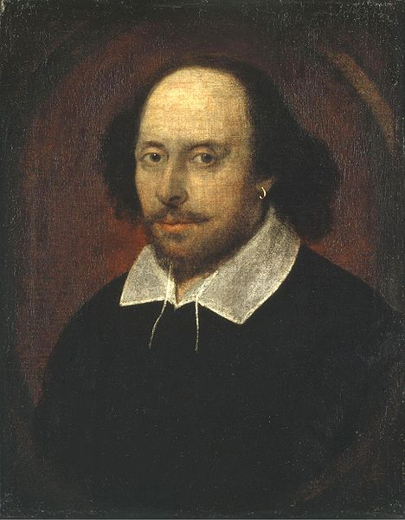
William Shakespeare
was born in April 1564.
He wrote 154 sonnets.
He educated at the local
grammar school, where
he studied Latin authors
and dramatists, logic.
Then he went to London.
He wrote many plays.
His famous works are "Hamlet",
"Romeo and Juliet".

Slide 8
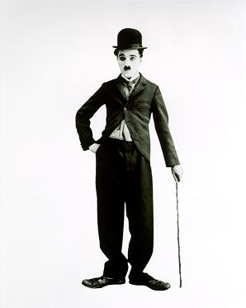
Charles Chaplin was born in London, on April 1889.
He started his career
as an actor when he was nine.
He went to America and
became the famous star,
Charlie Chaplin. The actor
died in 1977 but we still
remember his «Little Tramp»,
a funny little man in baggy
trousers and a small bowler hat.

Slide 9
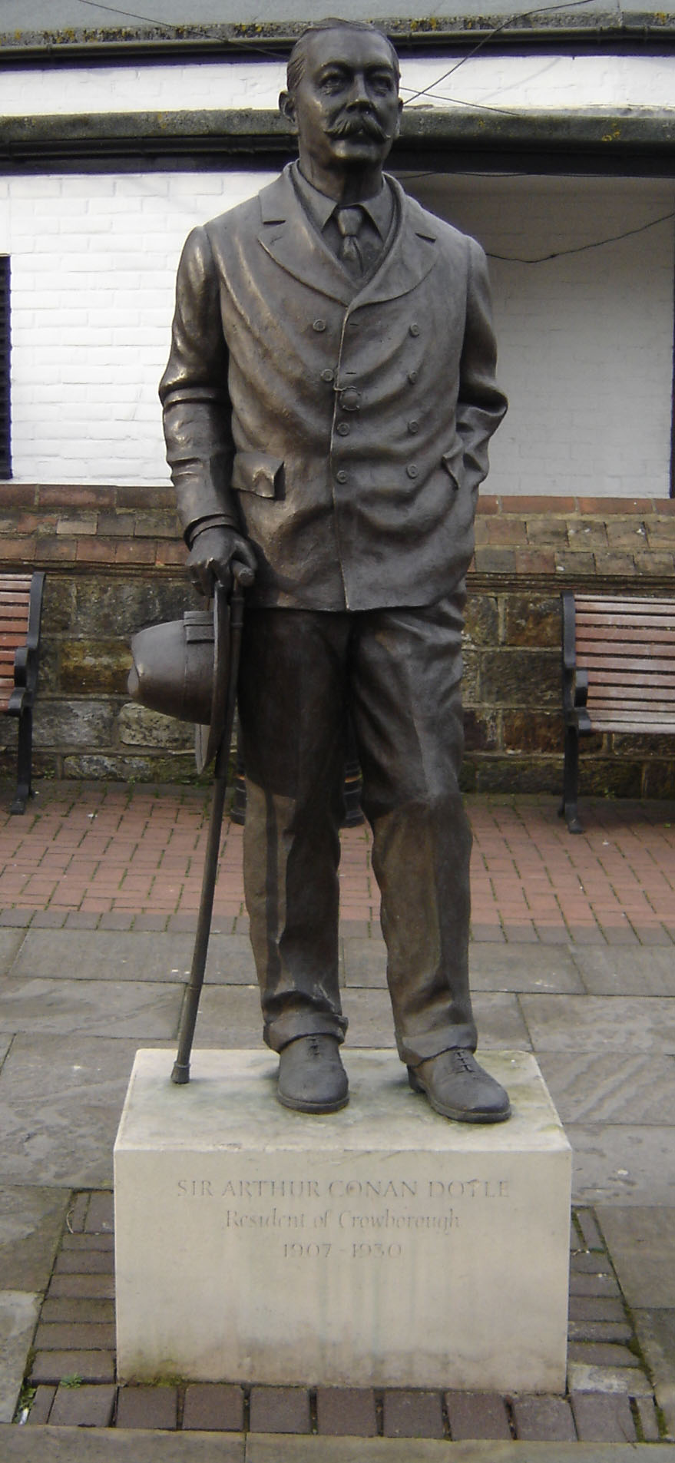
Sir Arthur Conan Doyle
was born in 1859 in Scotland.
He published his first detective story "A Study in Scarlet". Its main characters were Sherlock Holmes and Dr. Watson. The public liked these characters and demanded
more and more stories about Sherlock Holmes. In 1930 he died.

Slide 10
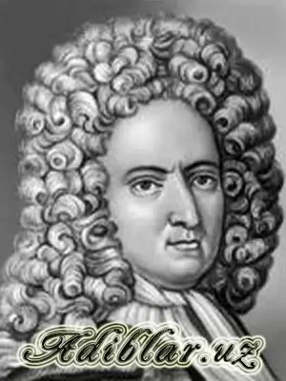
He was a writer of the
18th century. He wrote
his famous novel when
he was nearly 60 years old.
The story was based on the
real adventures of a sailor.
His book was published in 1719.
This novel is "The Life and
Strange Surprising Adventures
of Robinson Crusoe".

Slide 11
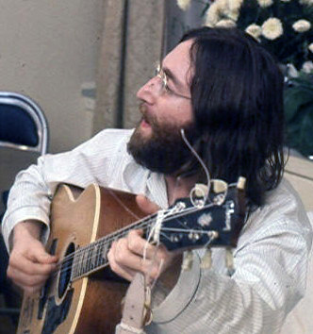
Lennon is a British rock
musician, singer, songwriter
and peace activist.
He is most famous as
a member of The Beatles.

Slide 12
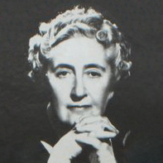
Agatha Christie was one
of England's most
famous writers. Her crime
and detective stores became
famous for their clever plots.
Agatha Christie was often called the queen of crime.

Slide 13
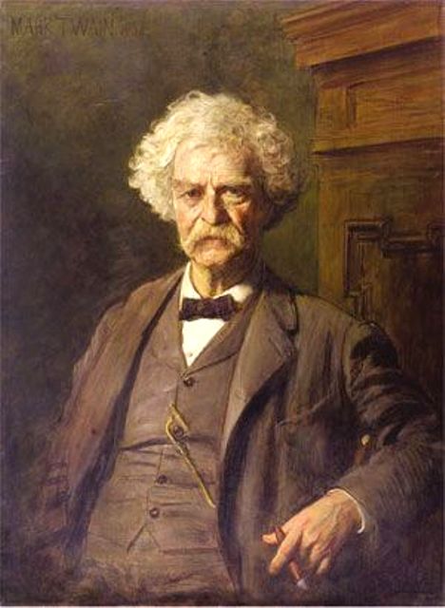
Samuel Langhorne Clemens
(Mark Twain) was born on
30 November 1835 in Florida.
Mark Twain became a famous
American author and orator.
A lot of critics and peers
The Adventures of Tom Sawyer and Adventures of Huckleberry Finn
made him noted. Mark Twain used
different pen names that’s why some
of his works are not known.

Slide 14
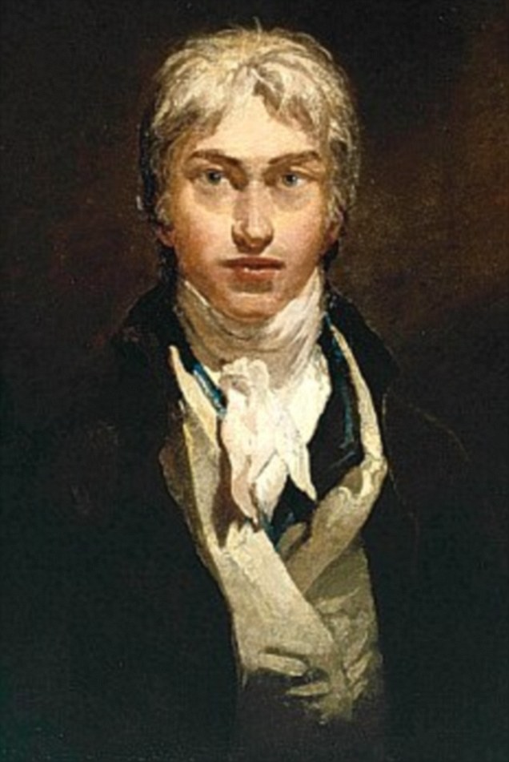
Joseph Turner was born in 1775.
Turner was very famous for the
wonderful colors in his pictures.
Most of them were landscapes
and sea pictures. He was a master
of watercolors.

Slide 15
Margaret Joseph William Daniel Agatha Charlie ARTHUR JOHN
Finish the second part of the name.

Slide 16
Quiz
Where was Conan Doyle born?
What the story based on real adventures?
Who wrote story about Romeo and Juliette?
Who is the Queen of detective stories?
What is the real name of Mark Twain?
Who is a member of group «The Beatles»?
Which jobs had Charlie Chaplin?

Slide 17
Home task
p.98, ex.7

Slide 18
Список использованных Интернет-ресурсов
http://images.yandex.ru/yandsearch?text=%D1%84%D0%BE%D1%82%D0%BE%20%D0%BC%D0%B0%D1%80%D0%BA%D0%B0%20%D1%82%D0%B2%D0%B5%D0%BD%D0%B0&stype=image&lr=53&noreask=1&source=wiz

