Slide 1
Welcome!
http://www.haglar.ru/image/data/clubs/YkX_9JB66KE.jpg

Slide 2
Food
http://o6oi.ru/main.php/110796-1/0006.jpg

Slide 3
[e]-
bread,
breakfast,
egg
[i:]-
tea,
sweet,
meat,
eat
[ɔ]-
porridge,
orange,
salt
[t]-
tomato,
potato
[ʌ]-
nuts,
butter,
mug
[æ]-
jam,
salad,
carrot
http://i.zlowiki.ru/110601_e3dee431.jpg

Slide 4
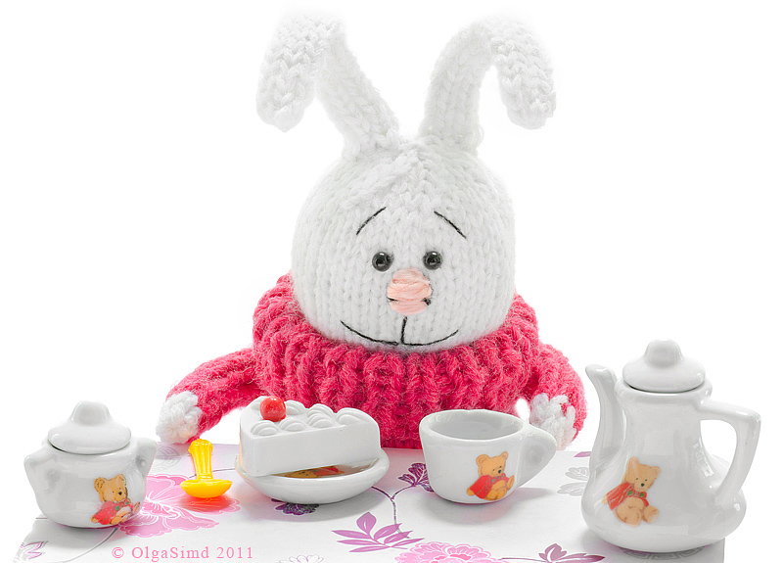
Dear friends! Please, come to my Birthday party on the 4th of March. From: Rabbit Pick, Magic forest

Slide 5
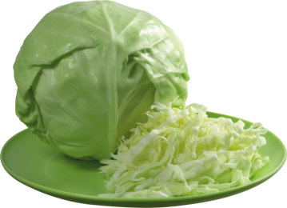
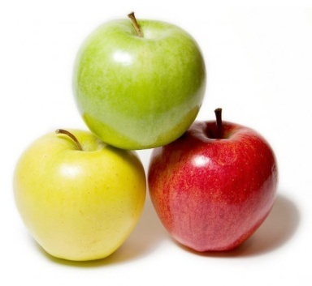
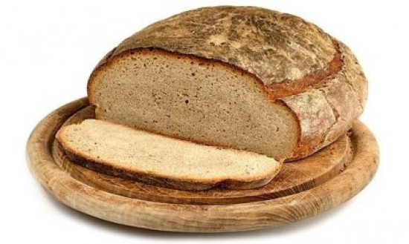
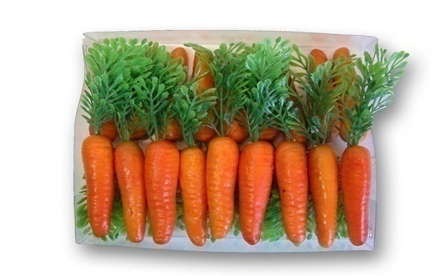
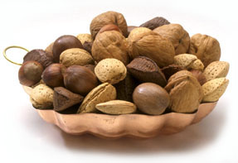
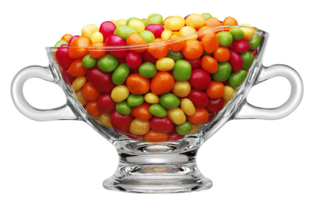
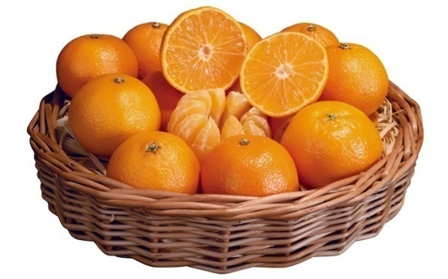
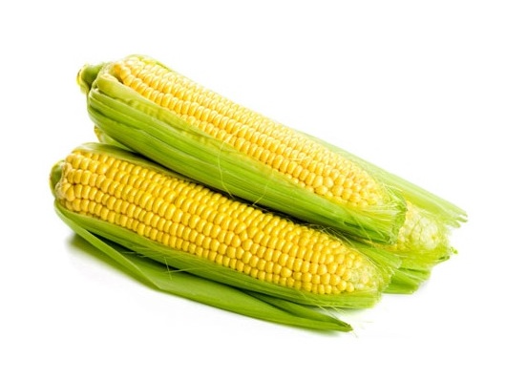
http://yandex.ru/images/

Slide 6
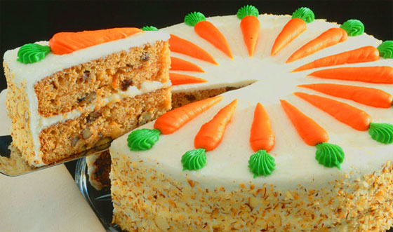
Let’s cook!
http://desktopwallpapers.

Slide 7
http://spectra-forum.ru/cfs-filesystemfile.ashx/__key/CommunityServer.Components.ImageFileViewer/CommunityServer.Discussions.Components.Files.1647/5556.197.gif_2D00_640x0.png

Slide 8
Green - excellent (5) Yellow- good (4) Red - not very good (3)
http://uploadimagex.com/uploads/2/4806.jpg

