Slide 1
Home sweet home

Slide 2
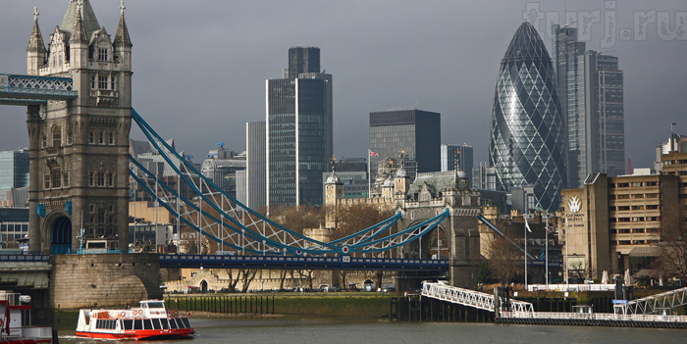
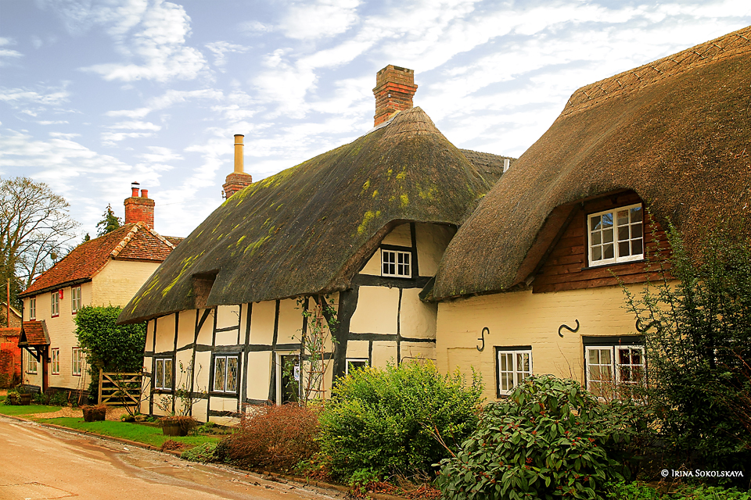
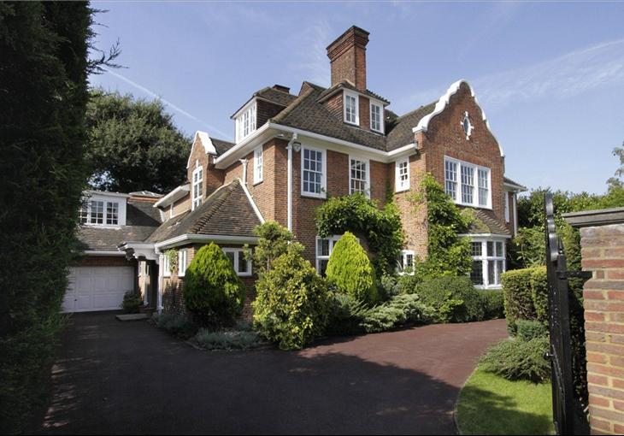

Slide 3
English proverbs
There is no place like home.
East or west, home is best.
My home is my castle.
Home sweet home.
Дом ,милый дом.
Мой дом- моя крепость.
В гостях хорошо, а дома лучше.
Нет места лучше дома.

Slide 4
Odd one out.
Table-desk-sofa
Carpet- chair- armchair
Kitchen-cooker-bed
Fridge-cooker- bedroom

Slide 5
Let’s have rest.

Slide 6
Correct answeres:
In
Under
On
In front of
Behind
On

Slide 7
Hometask:
Write a letter to an English pen-friend about your house.

Slide 8
for your work.

