Slide 1
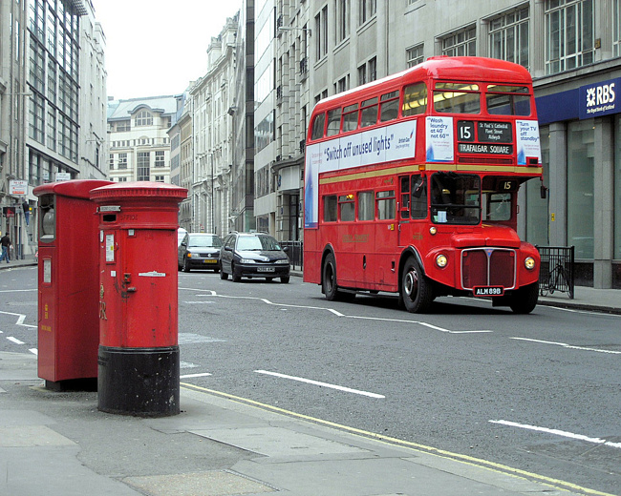
STAR HOUR

Slide 2
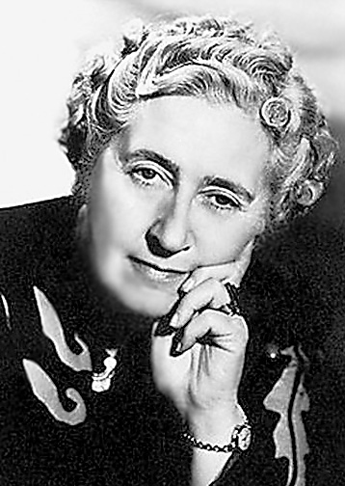
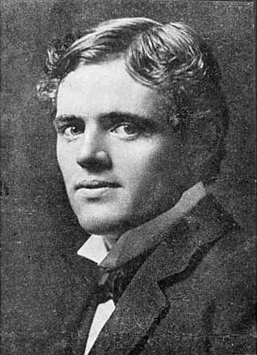
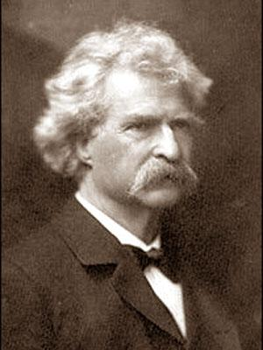
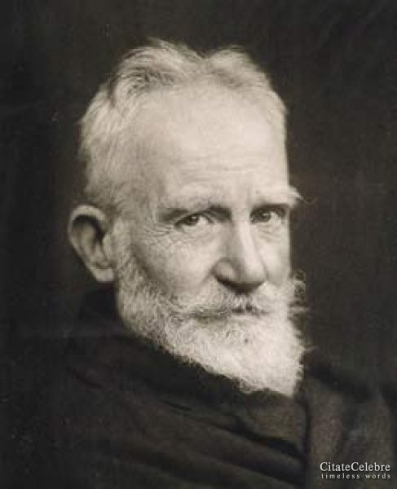
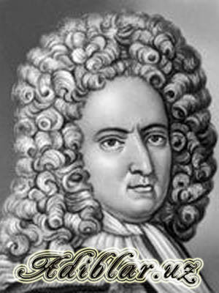
Do you know this writer?

Slide 3
It is an English writer whose most famous novels is «Robinson Crusoe»?
D. Defoe.
J. Swift.
Ch. Dickens.
W. Scott.

Slide 4
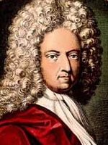
D. Defoe.

Slide 5
He wrote his famous novel «Oliver Twist» in 1838:
Jack London.
Conan Doyle.
Jerome K. Jerome.
Ch. Dickens.

Slide 6
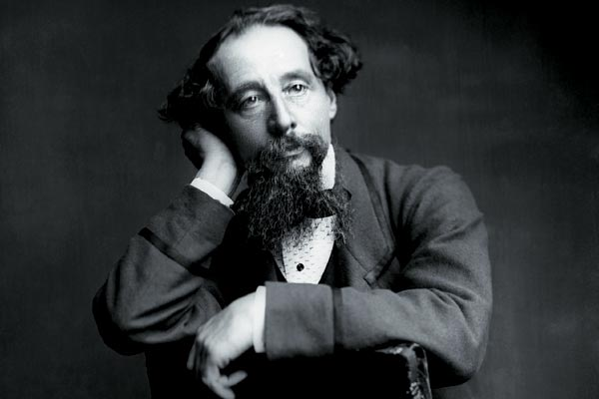
Ch. Dickens

Slide 7
In this town the tourists can see the house where Shakespeare lived with his family:
1.London.
2.Edinburg.
3.Wales.
4.Stratford-on-Avon.

Slide 8
Stratford-on-Avon.

Slide 9
«Tom Sawyer» is the famous novel written by a well- know writer:
Jerome K. Jerome.
B. Show.
Mark Twain.
Jack London.

Slide 10
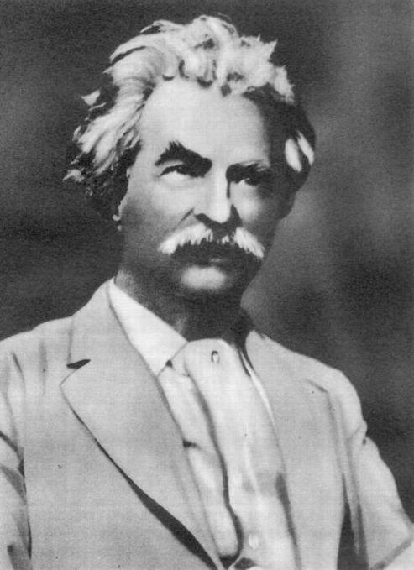
Mark Twain

Slide 11
«Treasure Island» is an adventure story about…………looking for buried treasure:
1.pirates
2.children
3.farmers
4.policemen

Slide 12
pirates

Slide 13
This writer began to write detective stories in 1920:
1.Jack London
2.Mark Twain
3.Agatha Christie
4.J. Chase

Slide 14
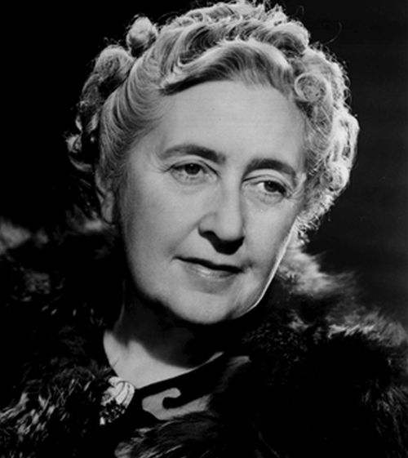
Agatha Christie

Slide 15
«Brown Wolf» was written by this writer:
1.Mark Twain.
2.Th. Dreiser.
3.Jack London.
4.Jerom K. Jerome.

Slide 16
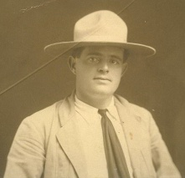
Jack London.

Slide 17
Edinburg, Cardiff, Dublin.
- I think that all these cities are capitals of the parts of the UK.

Slide 18
Snake, parrot, rabbit.
- I think that they are animals.

Slide 19
Believe, see, hear.
-I think that all this verbs can not be used in continuous tenses.

Slide 20
Pretty, beautiful, handsome.
-I think that all these words are synonyms.

Slide 21
Complicated, convenient, appearance.
- I think that there are no mistakes in this words.

Slide 22
Weather, rain, forecast.
-I think that all this words belong to one topic.

Slide 23
Hop, morning,glory,hawthorn.
- I think that all these words mean flowers.

Slide 24
Hedgehog, tiger, monkey.
- I think all these words mean animals.

