Slide 1
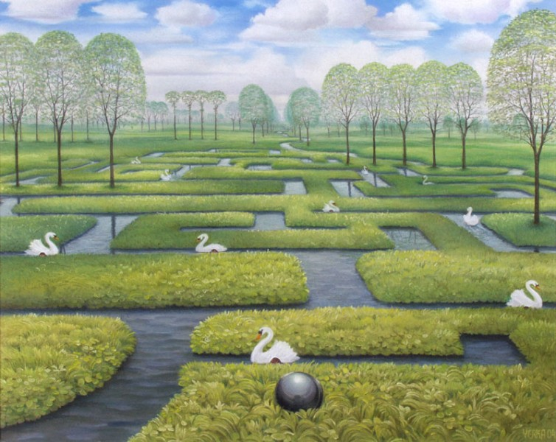
Волшебный лабиринт

Slide 2
Colored dream
D | C | L
O | N | A
G | U | K

Slide 3
Riddles. All in the family
1) Your mother’s father. 2) Your father’s sister. 3) Your father’s mother. 4) Your sister’s daughter.

Slide 4
Friendly numbers
Aa eight | Bb fifteen | Cc two | Dd six | Ee twenty | Ff seven
Gg ten | Hh seventeen | Ii fourteen | Jj eleven | Kk twelve | Ll nineteen
Mm twenty six | Nn five | Oo twenty five | Pp twenty one | Qq thirteen | Rr twenty two
Ss twenty three | Tt one | Uu sixteen | Vv three | Ww twenty four | Xx eighteen
Yy nine | Zz four

Slide 5
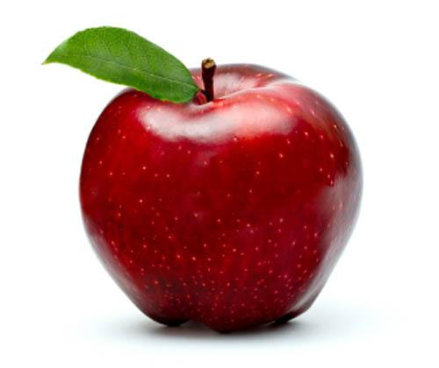
Puzzle
This picture is between a bird and an apple.
h
o
s

Slide 6
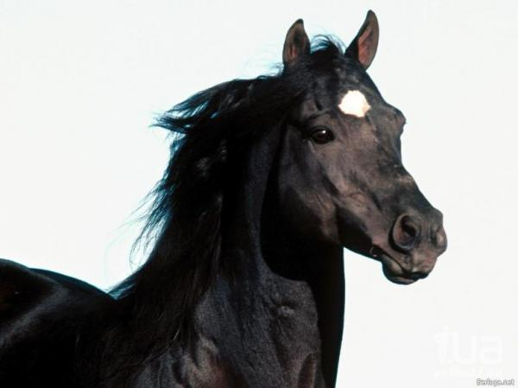
This picture is next to a policeman and a horse.
s
u
o

Slide 7
This picture is on the left of the flower.
u
e
h

Slide 8
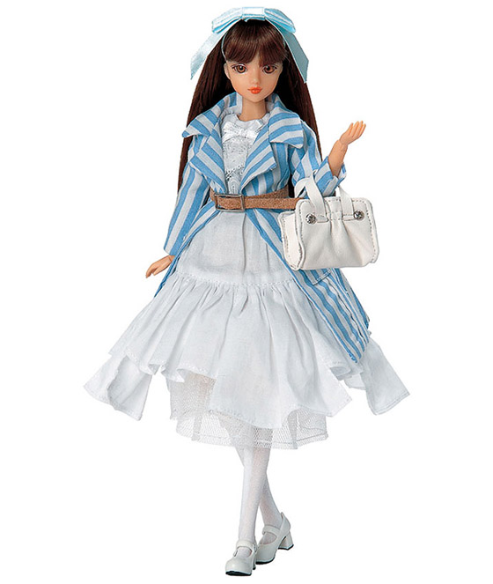
This picture is above the doll.
s
o
e

Slide 9
This picture is under a tree.
u
s
e

Slide 10
Crazy questions
1.Which is smaller? 4. Can a tiger swim?
- a mouse (b) - yes (k) - a fox (l) - no (m) - a hare (a) - sometimes (u)
2. Which can run faster?
- a zebra (s) - a bear (k) - a lion (o)
3. Can a penguin fly?
- yes (r) - no (o) - sometimes (e)

