Slide 1
Хабибуллина Диляра Гарифьяновна, учитель английского языка
МКОУ «Яланская средняя общеобразовательная школа»
Сафакулевского района

Slide 2
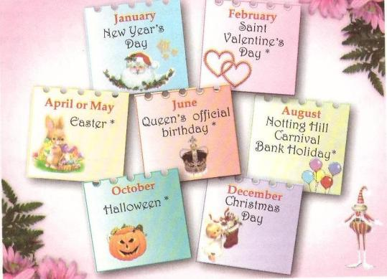
The 22nd of October.
How long is the British year?
Lesson 5, page 51 - 53

Slide 3
A black cat sat on a mat and ate a fat rat.

Slide 4
Why do you cry, Willy? Why do you cry? Why, Willy, Why, Willy, Why, Willy, why?

Slide 5
It's cold outside, isn't? You are excited today, aren't you? We had Apple Day party yesterday, didn‘t we? Как называется этот тип вопросов?

Slide 6
Read and make Tag questions
1.The English from age eighteen are independent persons, ...?
2. The British do the same in one and the same situation, ...?
3. You shouldn’t put a mountain of potatoes onto your guest’s plate, ...?
4. The English don't solve your problems, ...?

Slide 7
5. Leaving food is considered wasteful in Britain, …?
6. A small present will be okay in Britain, …?
7. The British will be pleased to get a thank-you letter or card from your home than to carry a heavy present, …?
8. The British customs of present-giving are very different from ours, …?

Slide 8
Word box
the Trooping the Colour – марш кавалерийского полка со знаменем
a carnival – ?
Caribbean – ?
Brazil – ?
Whit Monday – понедельник после Троицы
а bank – ?
карнавал
карибский
Бразилия, бразильский
банк

Slide 9
Read and translate:
royal traditions
dress up in national costumes
play tricks
an unusual race
a romantic festival of flowers
burn a straw guy
first-footing

Slide 10
Ophthalmotraining
Офтальмотренинг

Slide 11
Saint Valentine’s Day
February, 14
Was started in the time of Roman Empire.
Is dedicated to St. Valentine
February
Saint Valentine’s Day

Slide 12
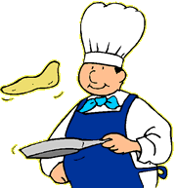
Pancake Day
In March
The last day before Lent.
Pancake race-running while holding a pancake in a frying pan . Competitors have to throw it in the air and catch it again in the pan.
March
Pancake Day

Slide 13
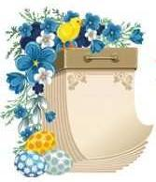
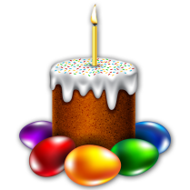
Easter
In April.
The celebration of the Resurrection of Christ .
Schools are closed for two weeks.
People give each other chocolate eggs that are wrapped in silver paper.
April
Easter

Slide 14
The London Marathon
One of the biggest marathons in the world.
Each year about 30,000 people start the race and about 25,000 finish.
Raise money for charity.
The London Marathon

Slide 15
Chelsea Flower Show
In May
Britain’s most important flower and garden show.
Thousands of people come to see the prize flowers and specially built gardens.
May
Chelsea Flower Show

Slide 16
Trooping The Colour
The second Saturday in June.
Celebrates the Queen’s official birthday.
Lots of marching, military music and the soldiers are dressed in colourful uniforms.
June
Trooping The Colour

Slide 17
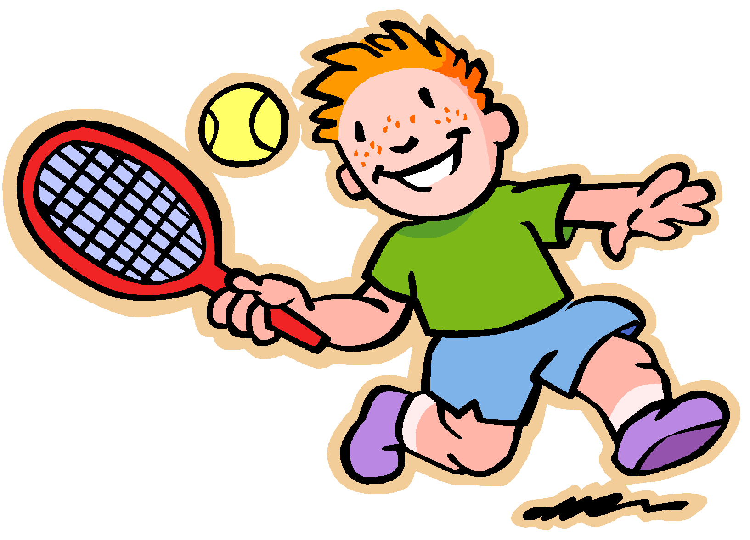
Wimbledon
The last week of June and the first week of July.
At Wimbledon in South-West London.
One of the four great world tennis championships and the only one which is played on grass.
June-July
Wimbledon

Slide 18
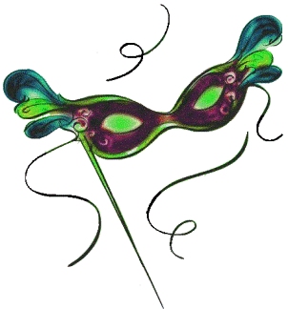
Notting Hill Carnival
The last weekend in August.
Takes place in Notting Hill.
People dress up in fabulous costumes.
Steel bands play African and Caribbean music.
August
Notting Hill Carnival

Slide 19
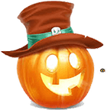
Halloween
October, 31
A pagan festival celebrates the return of the souls that visit their former houses
People dress up as witches, ghosts, etc.
Houses are decorated with pumpkins
October
Halloween

Slide 20
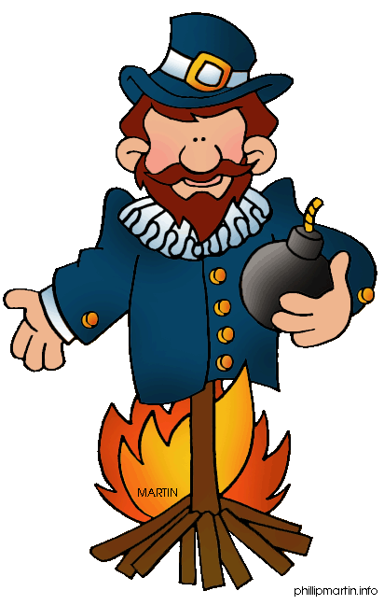
Guy Fawke’s Night
November, 5
He was a terrorist.
The day marks the discovery of a plot to blow up Parliament in 1605.
People make models of him and burn them on big bonfires
November
Guy Fawke’s Night

Slide 21
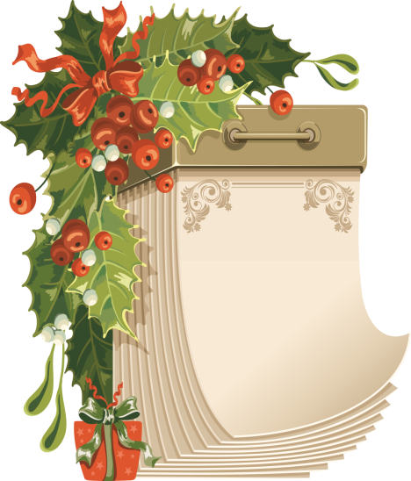
Christmas Day
December, 25
Religious ceremony commemorating the birth of Christ
Children wake up early to find presents in their stockings
Traditional Christmas tree and dinner
December
Christmas Day

Slide 22
New Year's Eve
December, 31
Traditionally Scottish celebration
At midnight everybody joins hands and sings Auld Lang Syne.
January
New Year’s Day

Slide 23
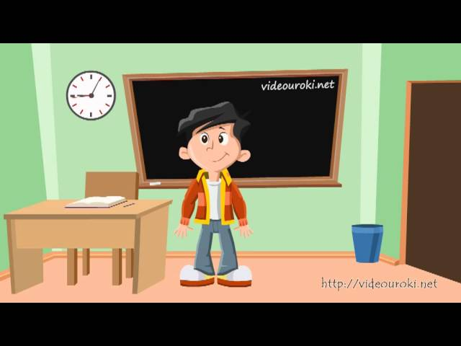
Супер физкультминутка

Slide 24
Сan you answer my questions?
1. Which festival is just British and very noisy one? -
2. When do people send cards to someone they are in love with? –
3. When do children dress up as witches?
-
4. When do British people have special dinner? -
5. When do British people have a big party in Trafalgar Square in London? -
Guy Fawkes’ Night
St Valentine Day
Halloween
Christmas
New Year

Slide 25
Look at the words and word combinations and say what occasions they belong to.
a bonfire
an unusual race
send postcards
ghosts and witches
fireworks
fancy costumes
a romantic festival
charity
beautiful gardens
play tricks
Halloween
Pancake Day
the Chelsea Flower Show
Guy Fawkes Night
the New Year
Words | a | b | c | d | e | f | g | h | i | j
Occasions
D
B
E
A
D
E
C
D
C
A

Slide 26
Home work: AB (Activity Book) ex. 1, p. 20-21 read the text about St. Valentine’s Day

Slide 27
Now express your mood!
Thank you for the lesson!
Good bye!

