Slide 1
There is no place like home

Slide 2
A cat: Little mouse, little mouse,
Where is your house?
A mouse: Pussy cat, pussy cat,
I`m a poor mouse
I have no house.

Slide 3
a living room

Slide 4
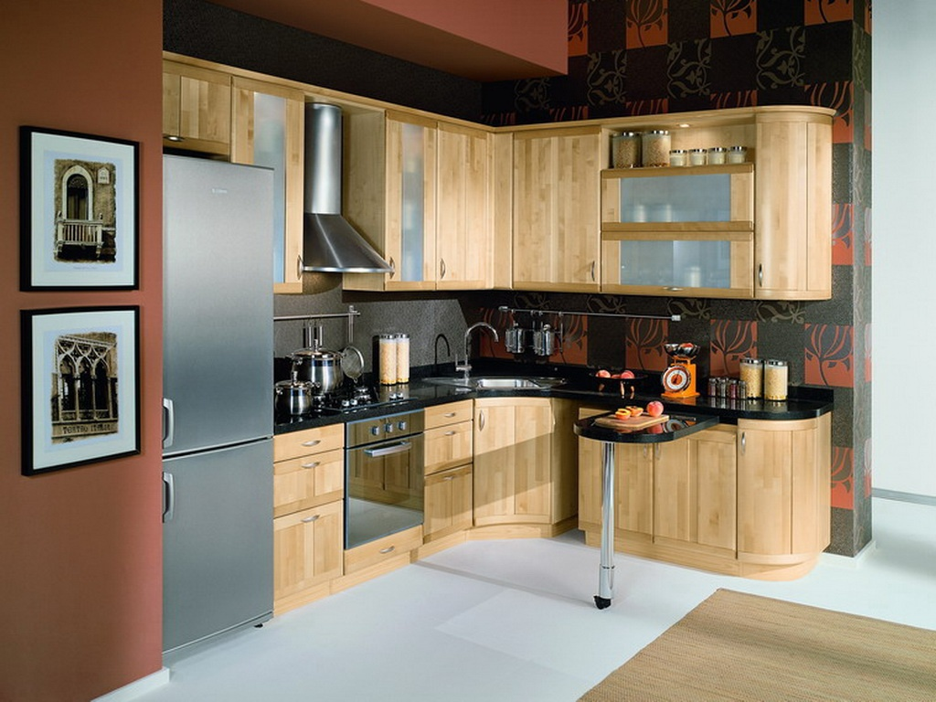
a kitchen

Slide 5
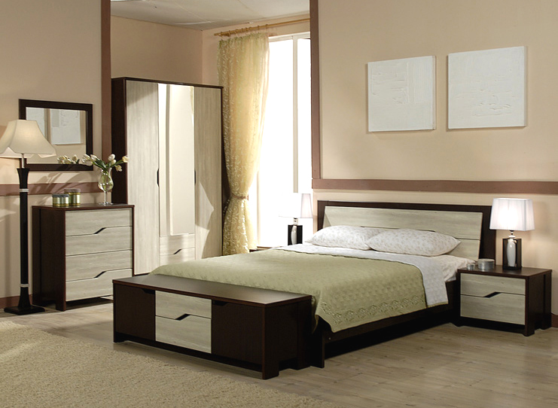
a bedroom

Slide 6
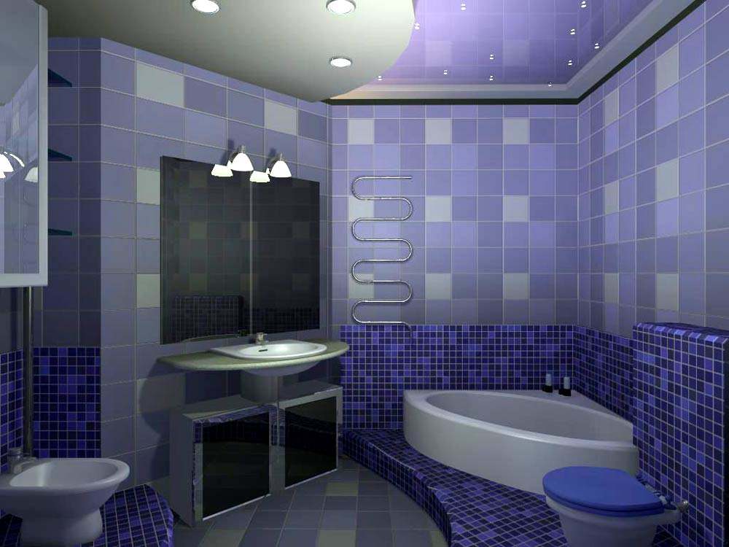
a bathroom

Slide 7
Furniture

Slide 8
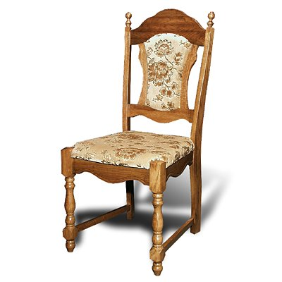
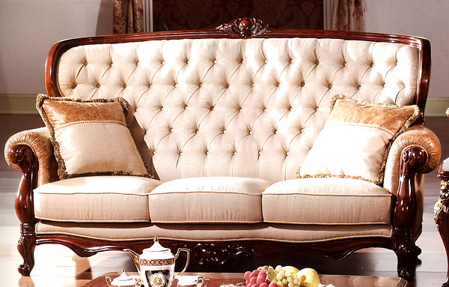
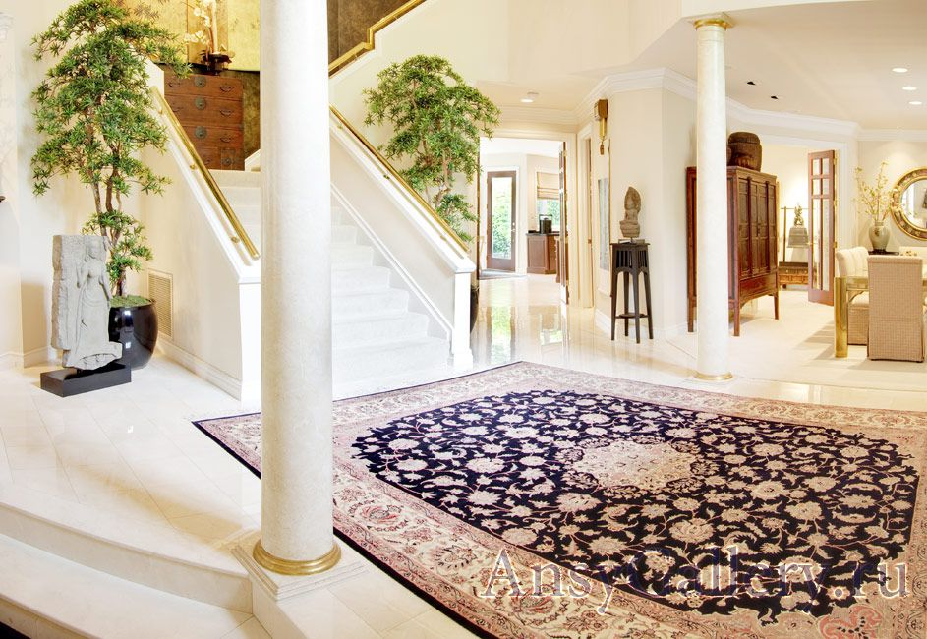
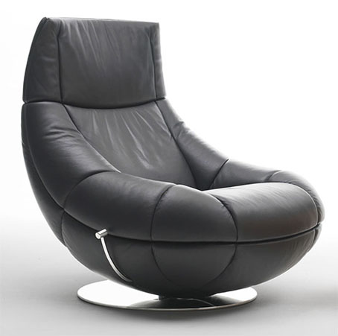
a chair
a sofa
a carpet
an armchair

Slide 9
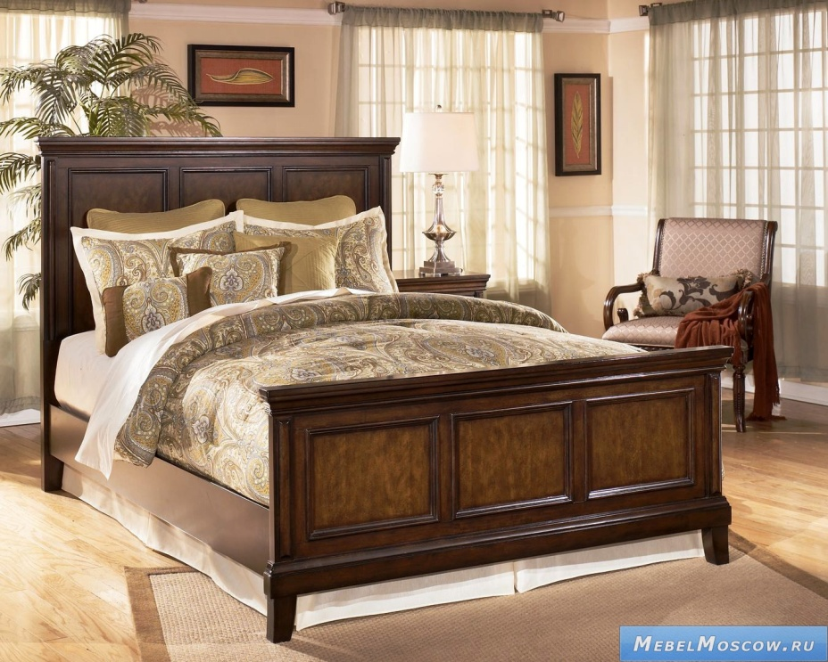
a sofa
a bed

Slide 10
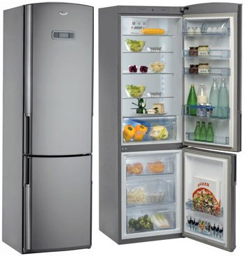
a fridge

Slide 11
a wardrobe

Slide 12
A kitchen
A living room
A bed room
A hall

Slide 13
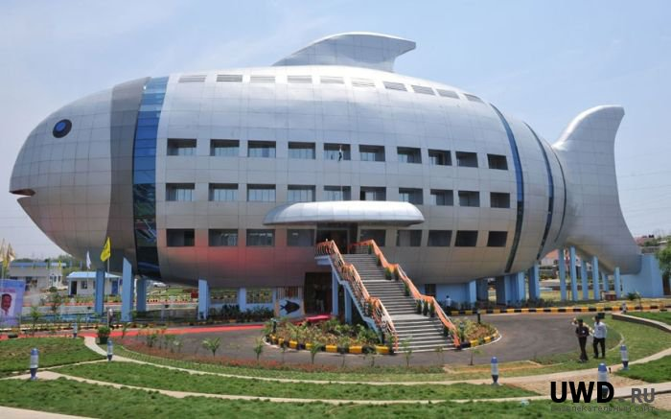

Slide 14
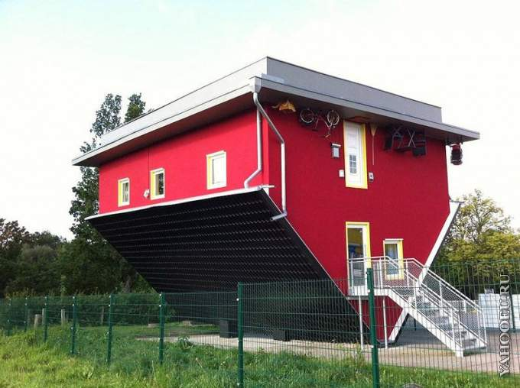

Slide 15
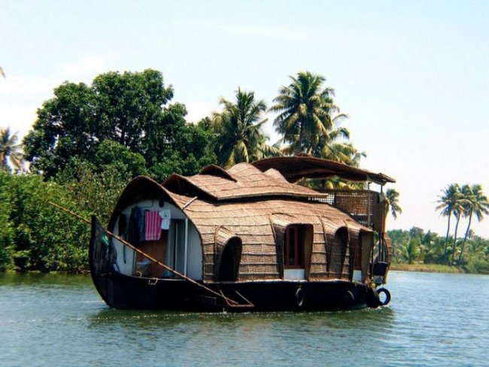

Slide 16
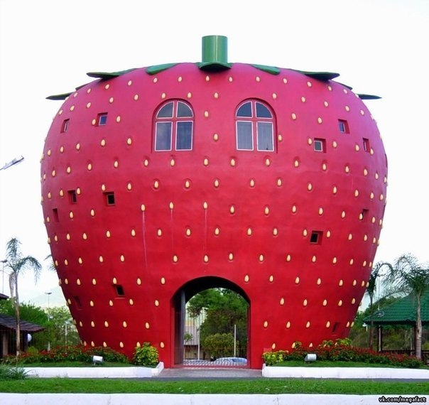

Slide 17
I live in a … .
I have got a … , … , … in my room.
I like my house because
there is no place like home!

