Slide 1
Victory day

Slide 2
Read the words
[e] – veteran, celebrate, decoration, celebration, help
[ai] – silence, fight, fine, nice
[i] – victory, defend, listen, kill, sing
[ei] - great holiday, Great Patriotic War, Victory Day, brave

Slide 3
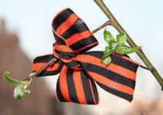
Answer the questions
1. When did the conflict start?
2. Where did the conflict start?
3. In what countries did the war happen?
4. Where is these countries situated?
5. Did your relatives take part in this war?
6. When do we celebrate this holiday?

Slide 4
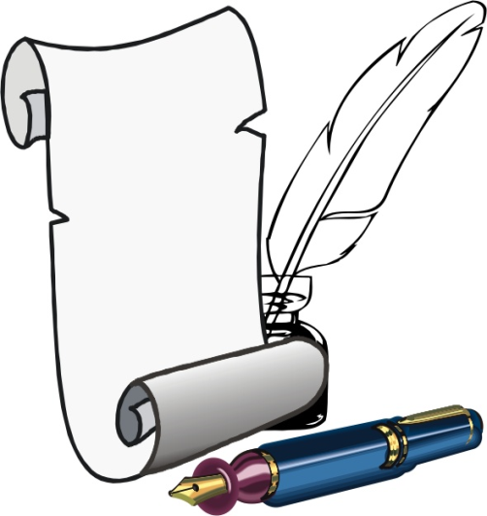
Read the word
flag флаг
slogan лозунг
demonstration демонстрация
meeting митинг. встреча
veteran ветеран
a military parade военный парад
defend защищать
defeat поражение
soldier солдат
hero герой

Slide 5
Victory Day
In Russia and other countries Victory Day, or the 9th of May, is one of the great holidays of the year. It is the holiday of all people.
In all the towns there are decorations, flags, and slogans in the streets, in the shop windows and on the front of large buildings.
On Victory Day morning there are meetings and demonstrations of the veterans who fought in the Great Patriotic War.
On that day there usually is a military parade in all big cities of our country.
There are a lot of people in the streets and squares, at theatres, cinemas and concert halls. They are all celebrating their holiday. Many people go to see their friends or go for walks in the parks or forests.

Slide 6
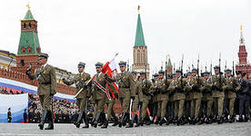
Answer the questions
When do people celebrate Victory Day?
What are there in all the towns?
What do people do in this day?

