Slide 1
Подготовка к проекту «Меню школьных завтраков»

Slide 2
Say the sounds and the products with them

Slide 3
Read after me
[i:]- eat, teach, clean, speak, cream, jeans, please.
[t∫]- chin, chick, cheese, chain, chalk, charm.
[∫]- ship, sheep, shy, fish, shirt, shop, short.
[ɵ]- think, three, Thursday, thank.
[ð]- the, this, that, they, their.

Slide 4
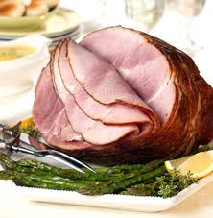
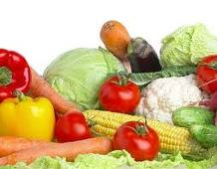
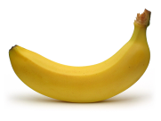
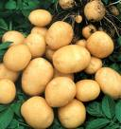
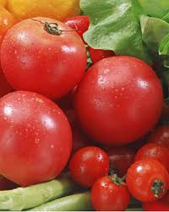
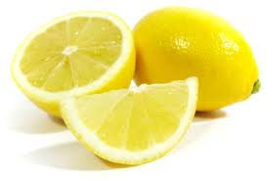
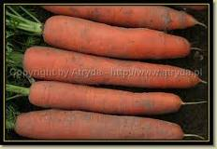
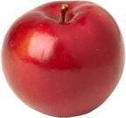
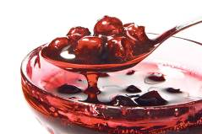
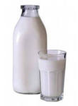
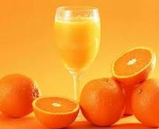
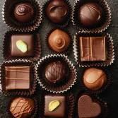
Healthy food

Slide 5
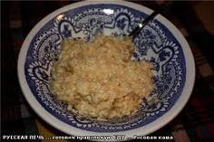
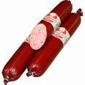
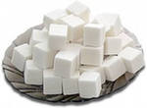
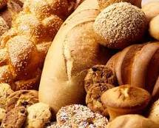
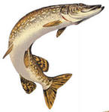
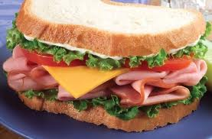
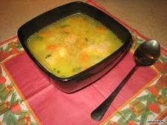
Unhealthy food

Slide 6
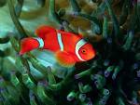
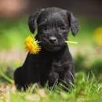
Let’s move and relax!
It’s a bird,
It can sing.
It’s a fish,
It can swim.
It’s a dog,
It can run.
It is me,
I can jump!

Slide 7
What’s a healthy breakfast?

Slide 8
Make up your own menu
Menu

Slide 9
WELL DONE!
Your marks are…
Your home task is…

