Slide 1
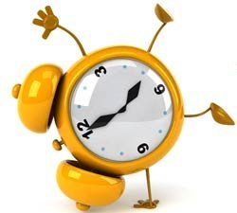
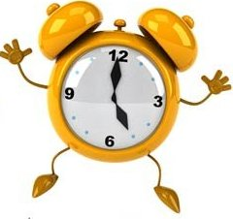
What’s the time?

Slide 2
“Tick-tock, tick-tock”, Ticks Tommy’s clock. “Tick-tock, tick-a- tock”, Ticks and ticks his clock

Slide 3
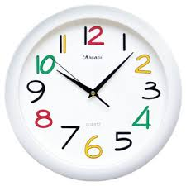
A face
Hour hand
Minute hand

Slide 4
Asking and Telling the time:
-What’s the time?
-It’s 5 o’clock.

Slide 5
What’s the time?
o’clock
5 minutes past
a quarter to
A quarter past
20 minutes to
A half

Slide 6
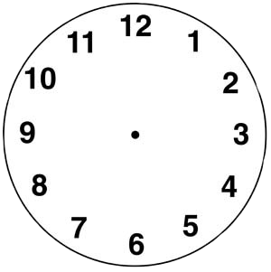
What’s the time?
It is ten minutes past twelve
It is ten minutes to two
It is а quarter to one
It is half past twelve

Slide 7
Good luck!

